Slide 1
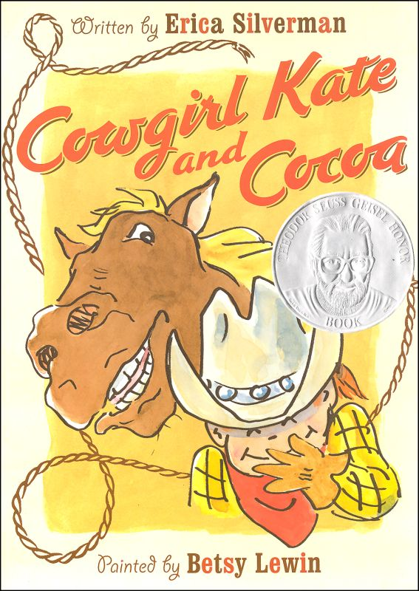
Reading with Expression
2nd Grade Unit 2

Slide 2
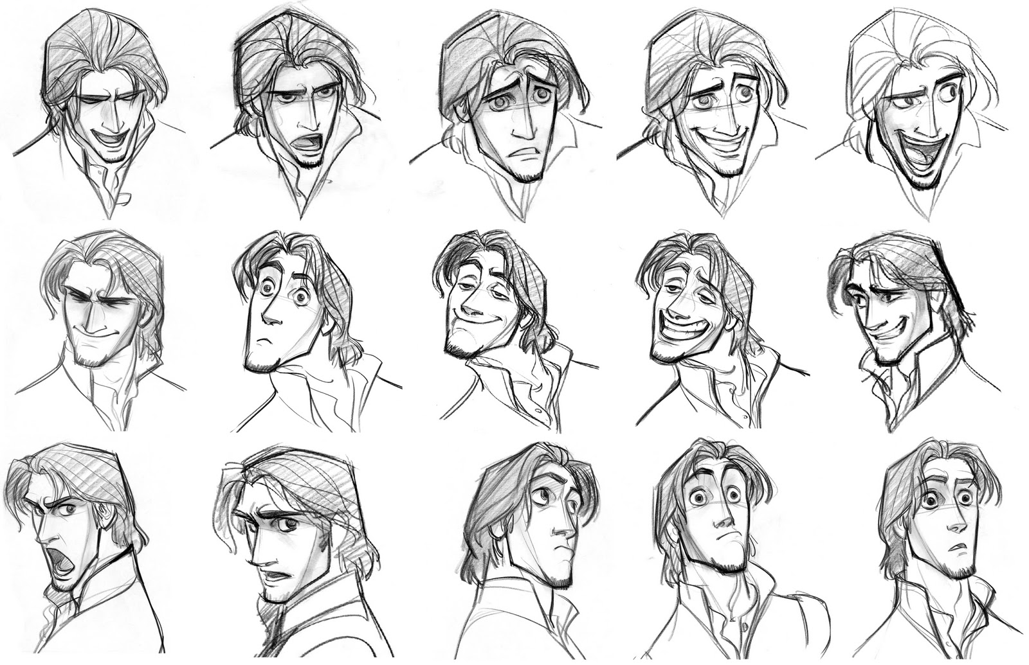
What do you notice about this series of drawings?

Slide 3
Goal-
I can read with expression.

Slide 4
When you read with expression, you change your voice to match the characters feelings.
“What did you say?”
Notes:
Click for different facial expressions.

Slide 5
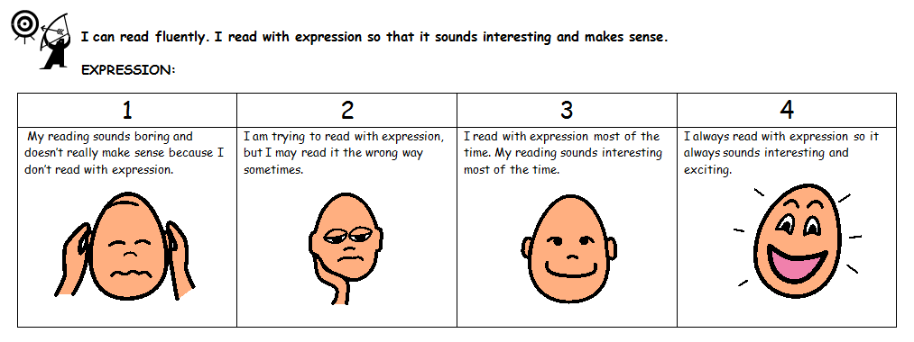
We are going to practice reading with expression. You will score yourself using this rubric.

Slide 6
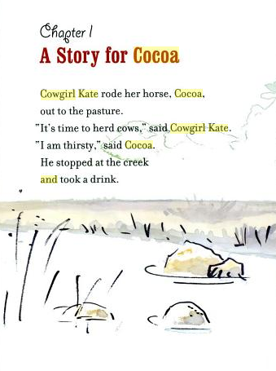
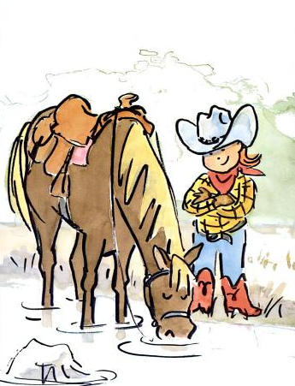

Slide 7
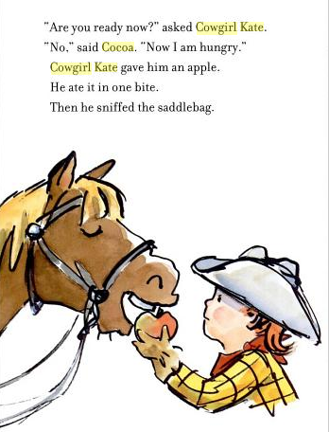
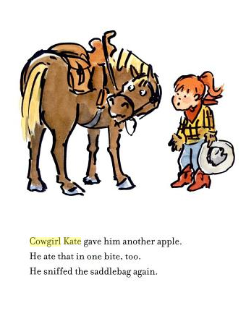

Slide 8
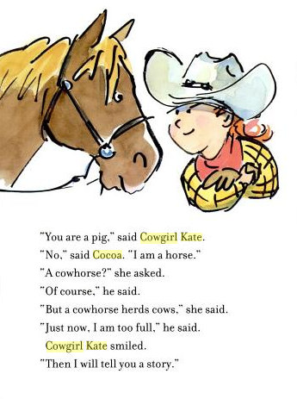

Slide 9
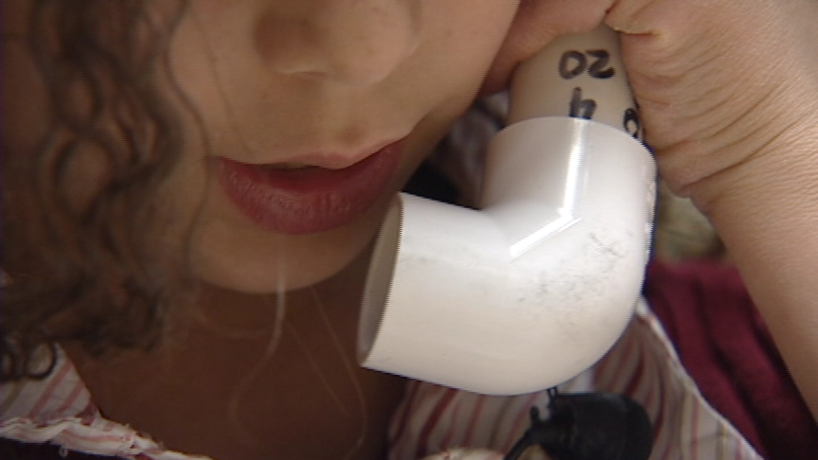
1. Read the next chapter to yourself.
2. Re-read it.
3. Score yourself using the expression rubric.

